Slide 1
Hand recognition
Jacky Le

Slide 2

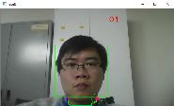
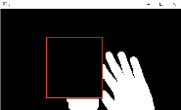
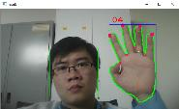
Hand recognition Flow chart
Get the skin color
profile & remove
Face
Src Image
Face Detect
Hand recognition

Slide 3
Face Detection
Face Detect: use Haar Cascades method
facecad.detectMultiScale(frame_gray, faces, 1.1, 2, 0 | CV_HAAR_SCALE_IMAGE, cv::Size(30, 30));
for (int i = 0; i < faces.size(); i++) //consider the first face
{
cv::Point center(faces[i].x + faces[i].width*0.5, faces[i].y + faces[i].height*0.5);
maxareai = (faces[i].area() > maxarea) ? i : maxareai;
maxarea = (faces[i].area() > maxarea) ? faces[i].area() : maxarea;
ellipse(myframe, center, cv::Size(faces[i].width*0.5, faces[i].height*0.5), 0, 0, 360, cv::Scalar(255, 0, 255), 4, 8, 0);
}
http://docs.opencv.org/trunk/d7/d8b/tutorial_py_face_detection.html

Slide 4
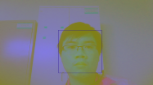
Get skin color profile & remove face
Get the skin color
profile
Remove face area
& binary remain img by YCrCb profile
Face Detect
Get profile color from face (YCrCb)

Slide 5
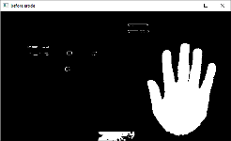
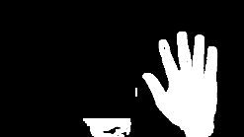
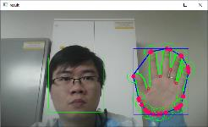
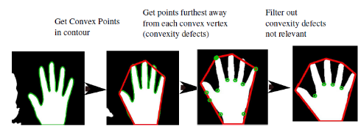
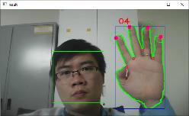
Hand recognition Flow chart
Before erode/ditale
After erode/ dilate
Find hull/conv.defect
Noise removed
Get the finger

